Slide 1
Chapter 9 Hands on Machine Learning
황 성 윤
Reference : https://github.com/rickiepark/handson-ml

Slide 2
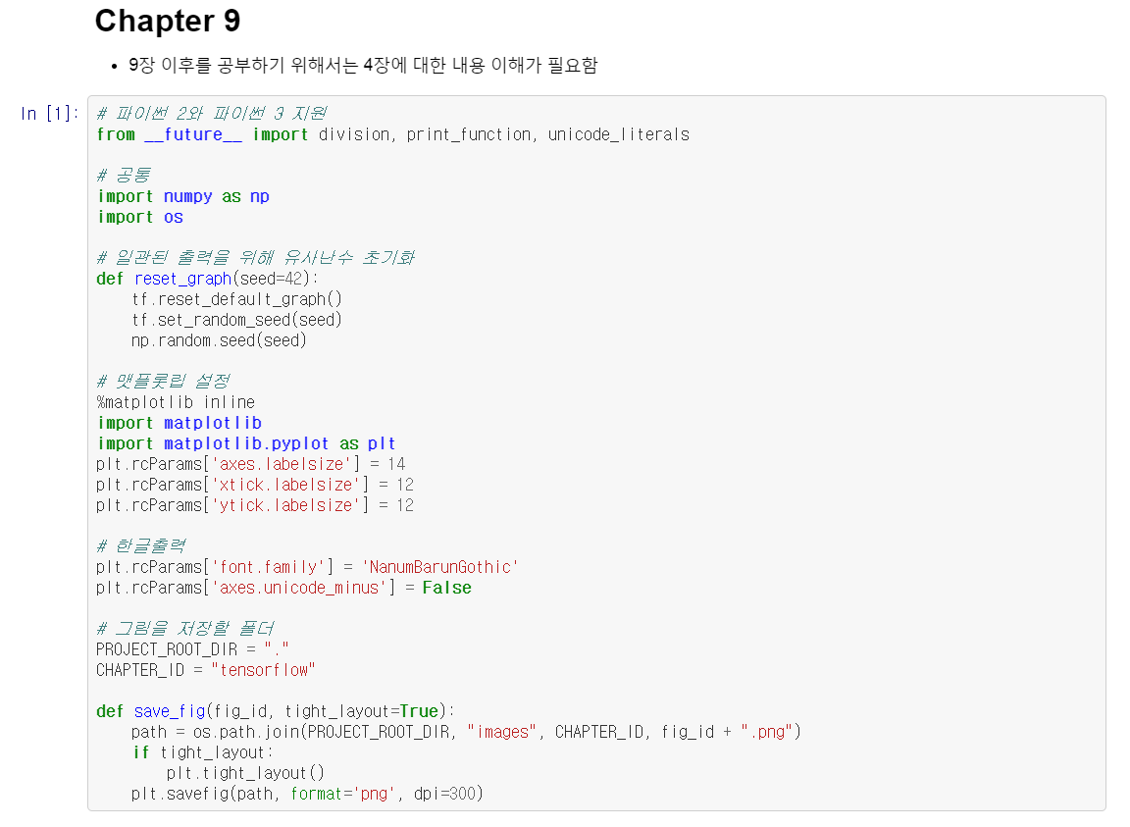
Chapter 9

Slide 3

Chapter 9

Slide 4
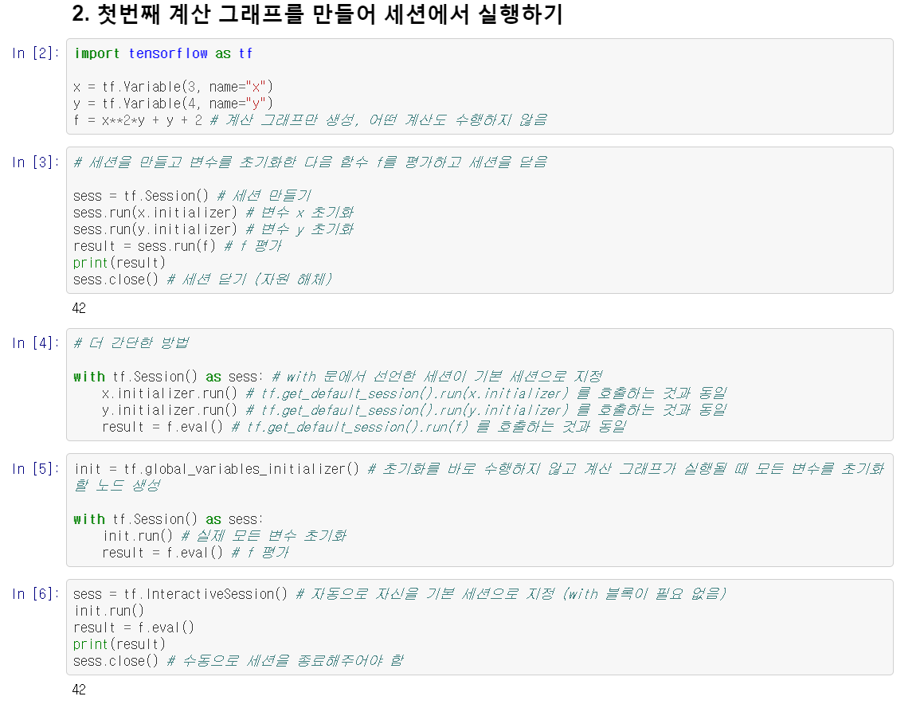
Chapter 9

Slide 5
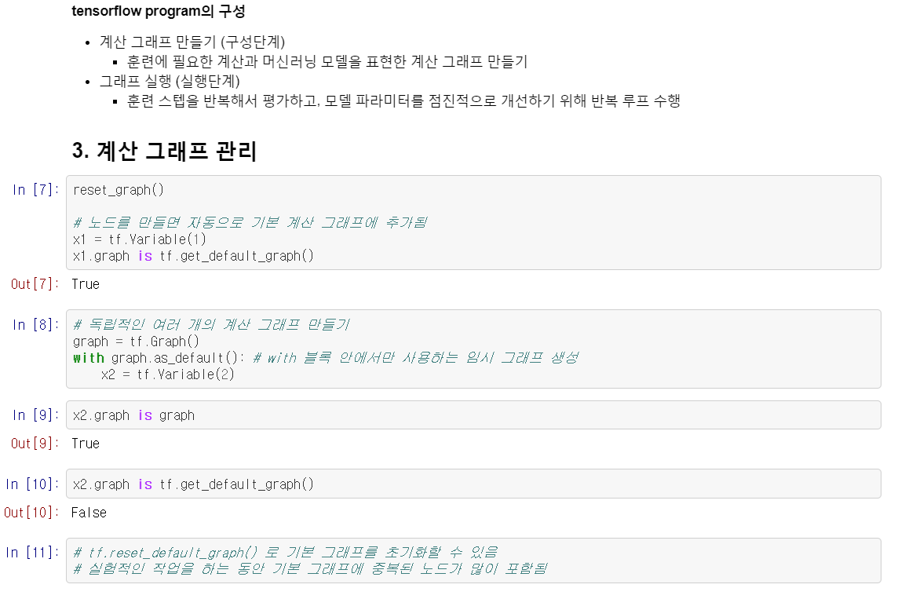
Chapter 9

Slide 6
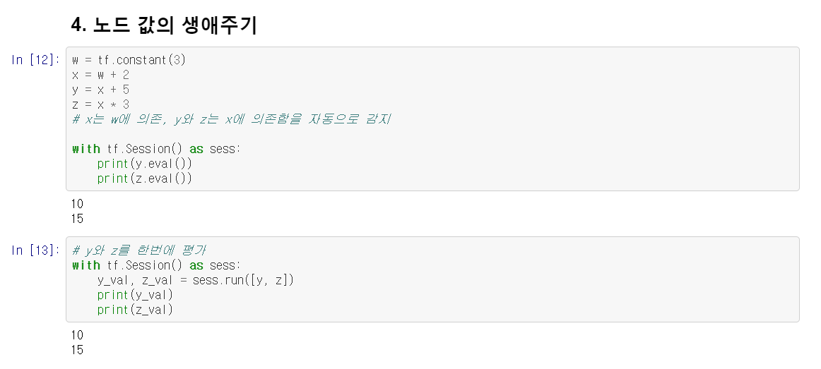
Chapter 9

Slide 7
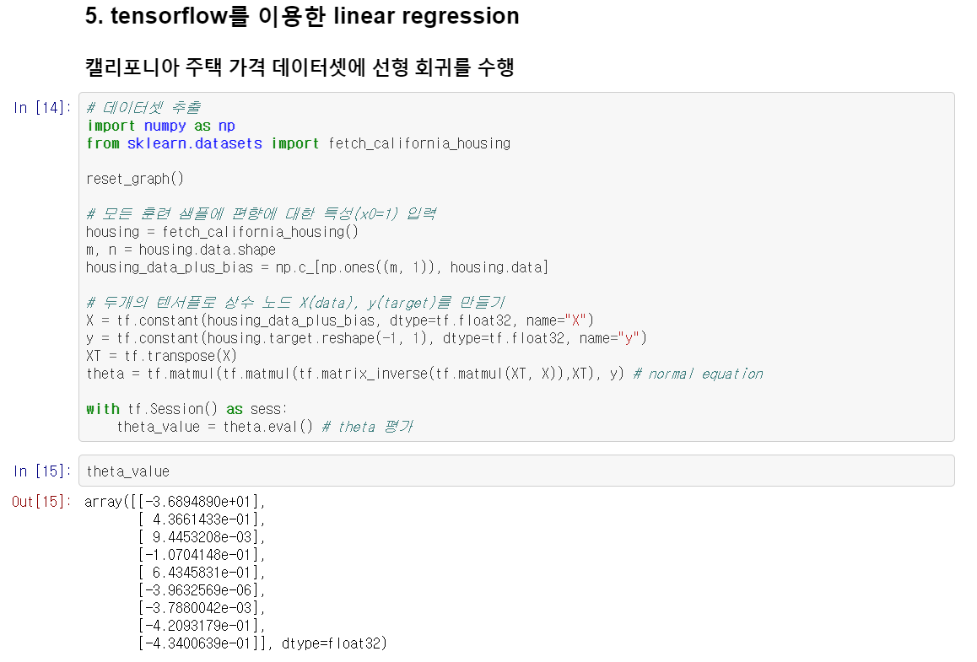
Chapter 9

Slide 8
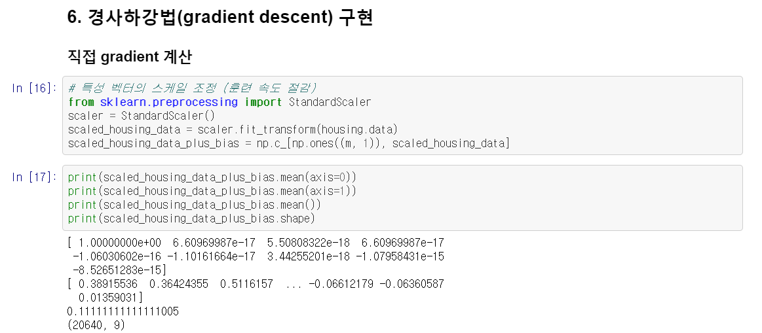
Chapter 9

Slide 9
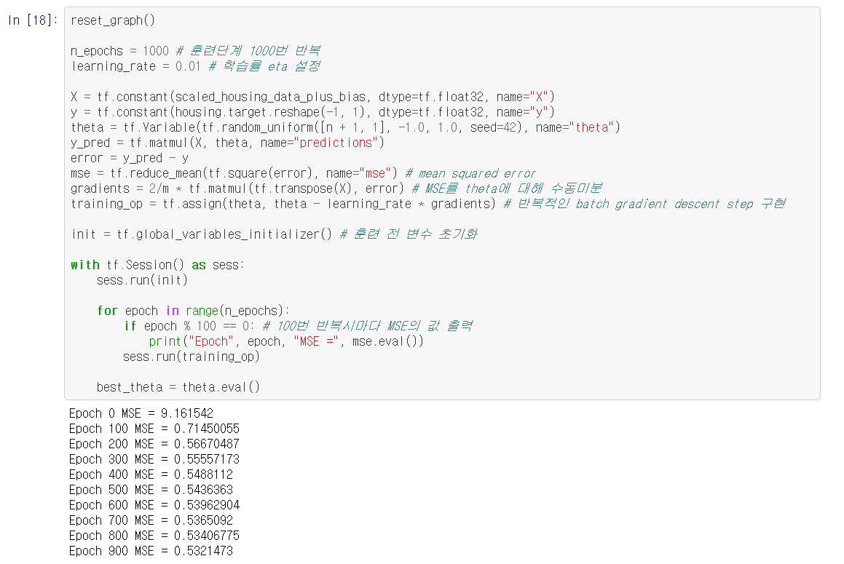
Chapter 9

Slide 10

Chapter 9

Slide 11
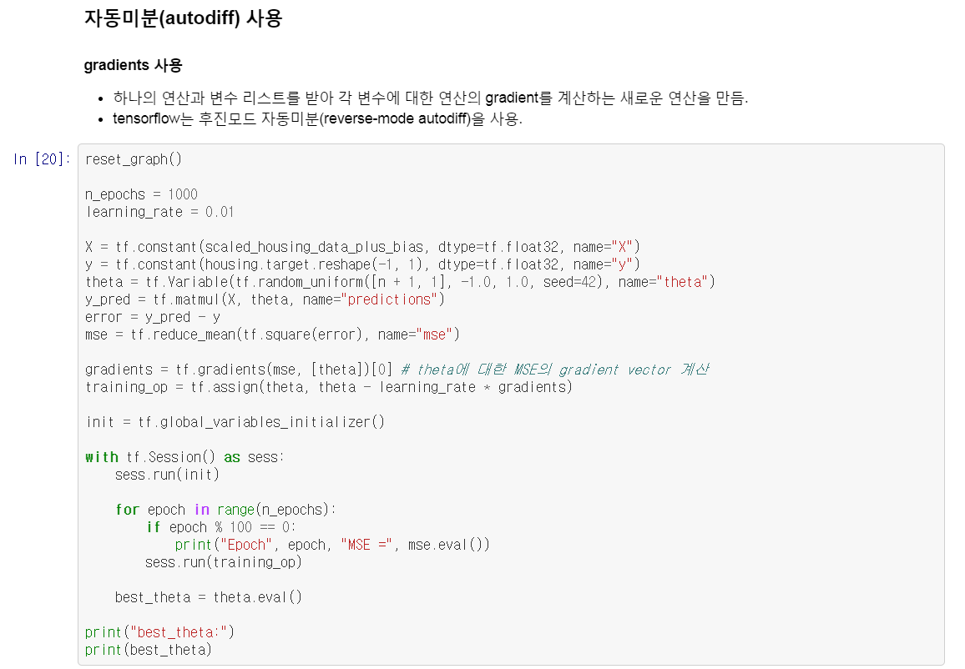
Chapter 9

Slide 12
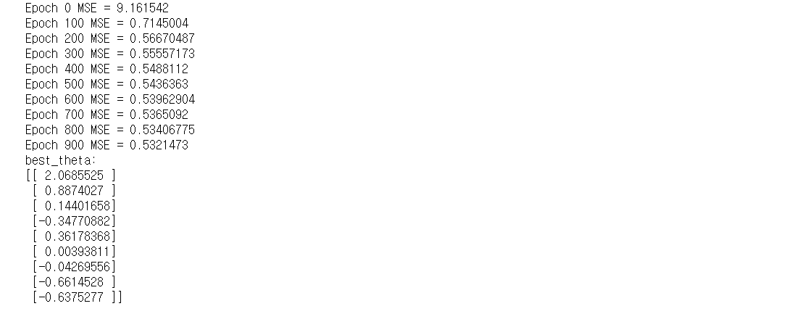
Chapter 9

Slide 13
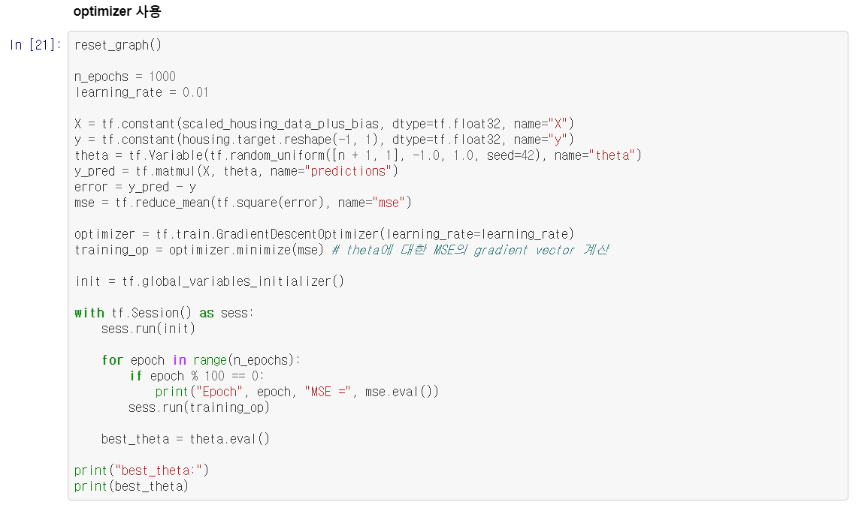
Chapter 9

Slide 14
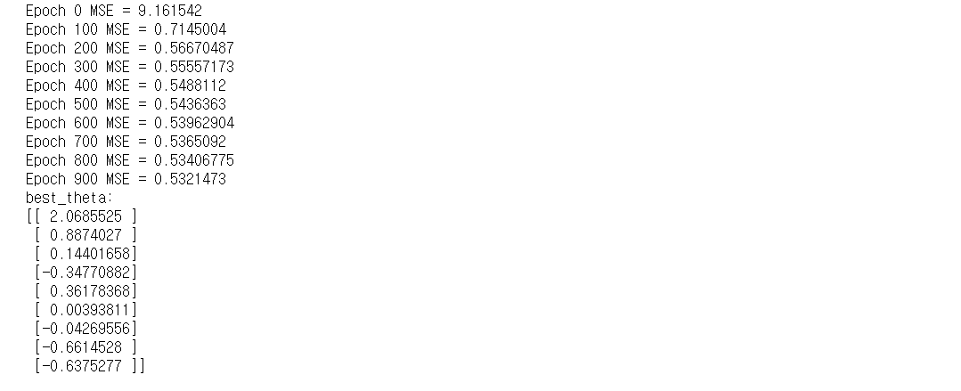
Chapter 9

Slide 15
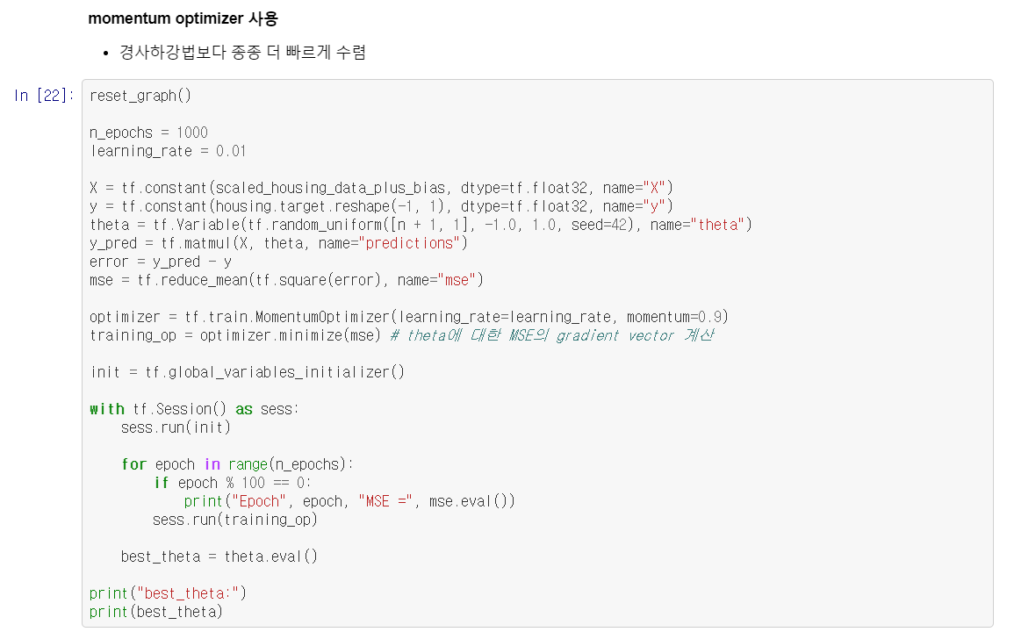
Chapter 9

Slide 16
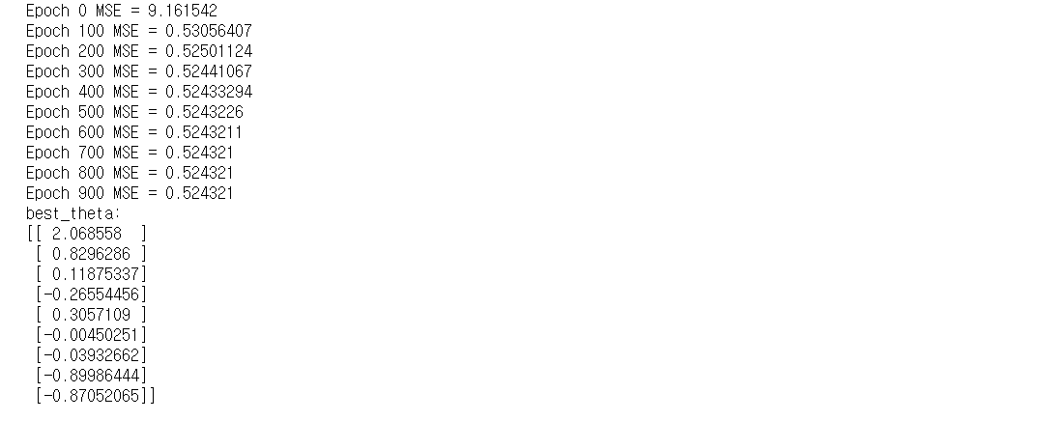
Chapter 9

Slide 17
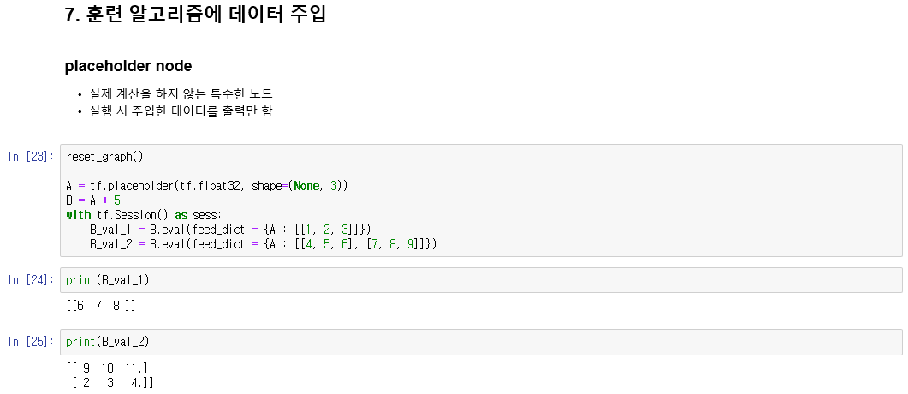
Chapter 9

Slide 18
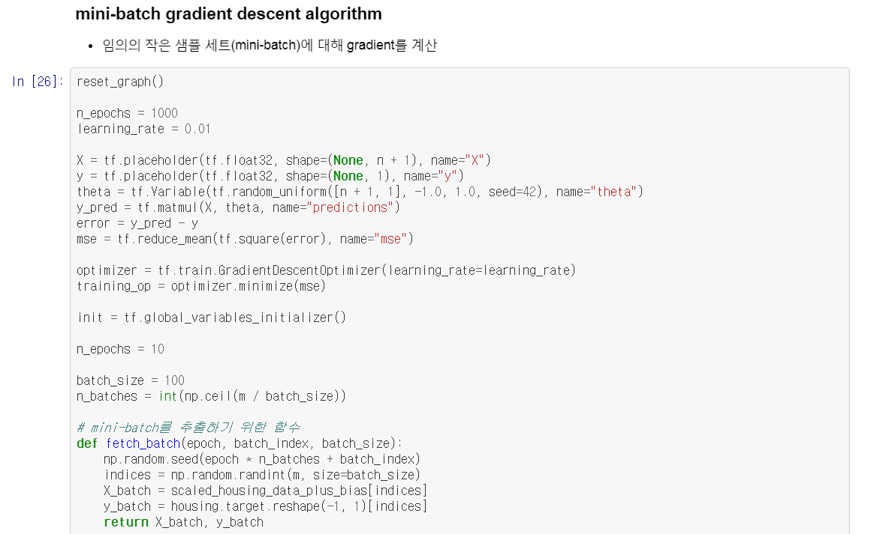
Chapter 9

Slide 19
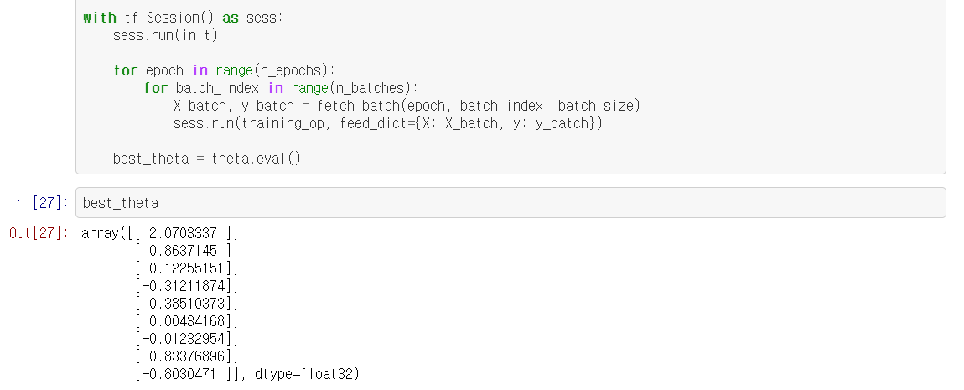
Chapter 9

Slide 20
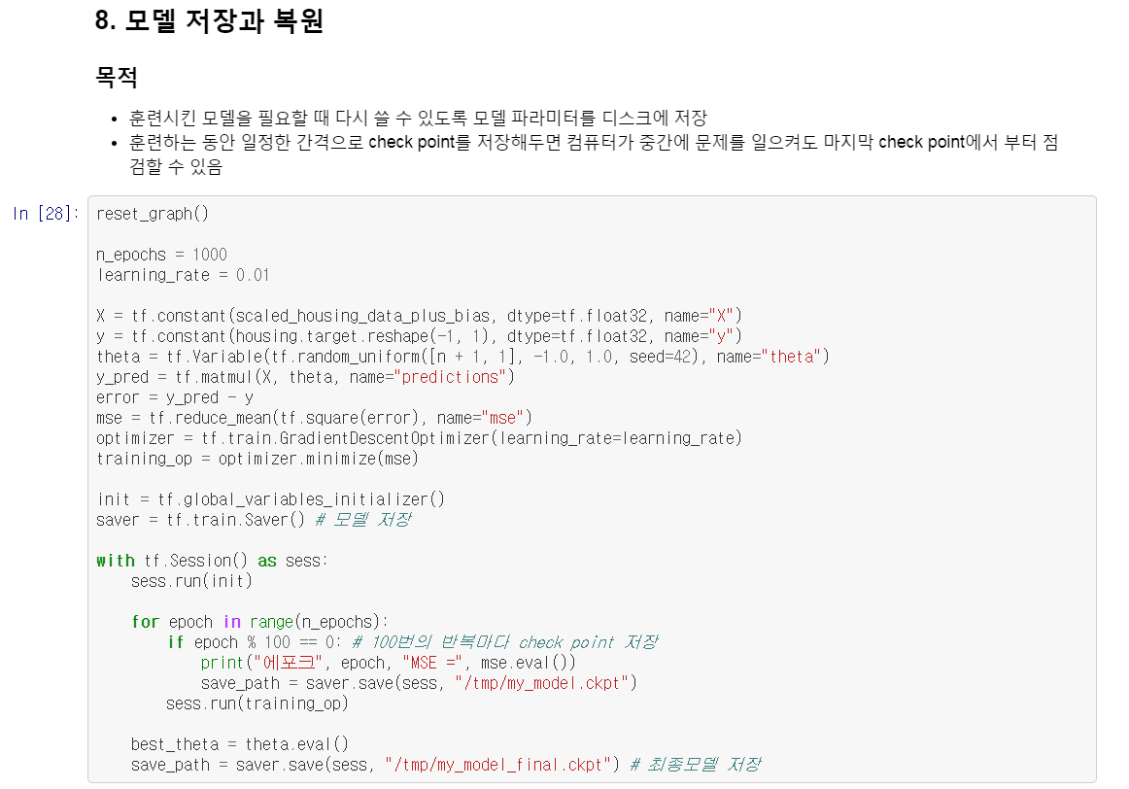
Chapter 9

Slide 21
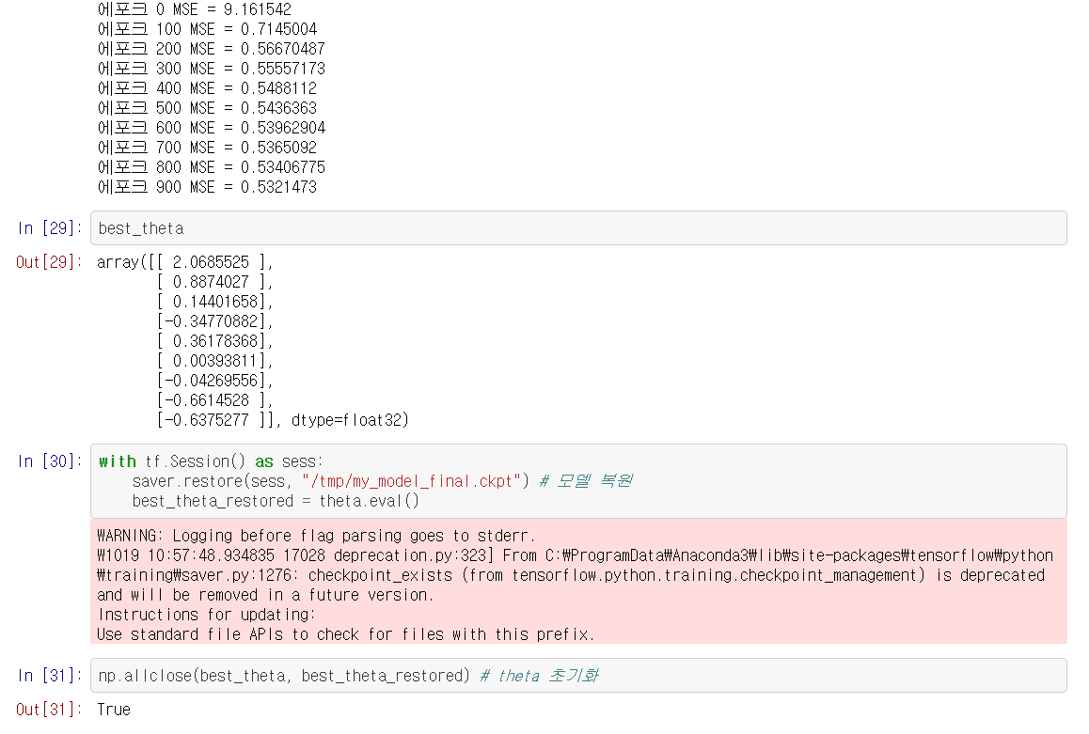
Chapter 9

Slide 22
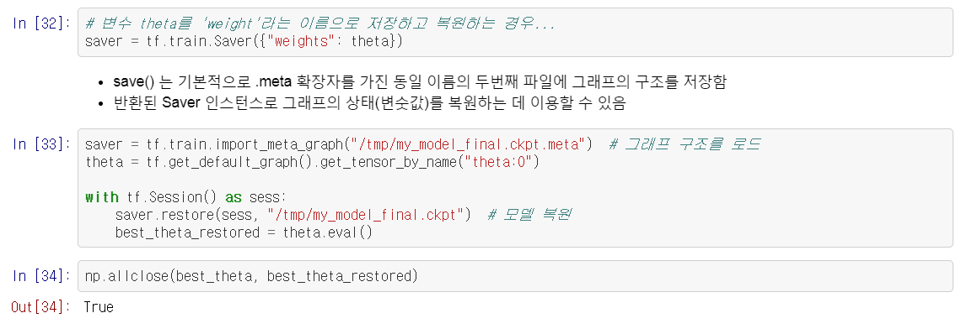
Chapter 9

Slide 23
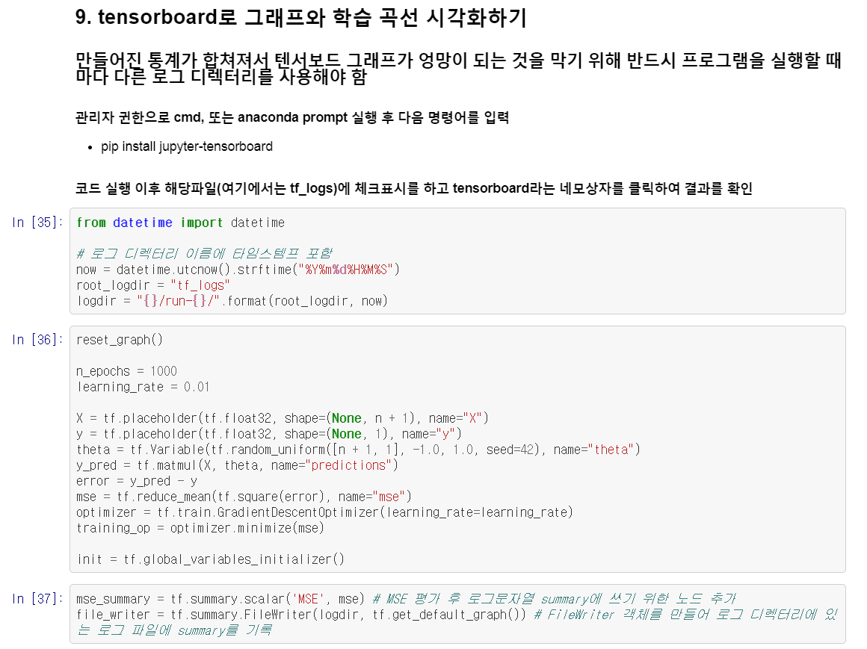
Chapter 9

Slide 24
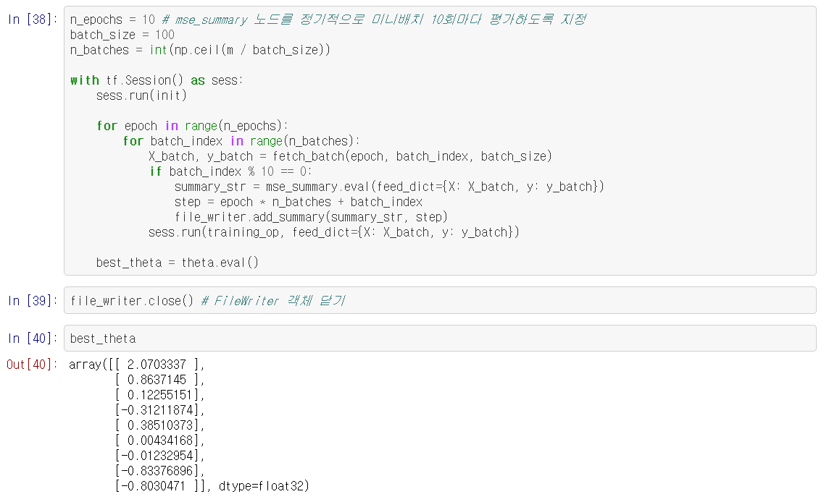
Chapter 9

Slide 25
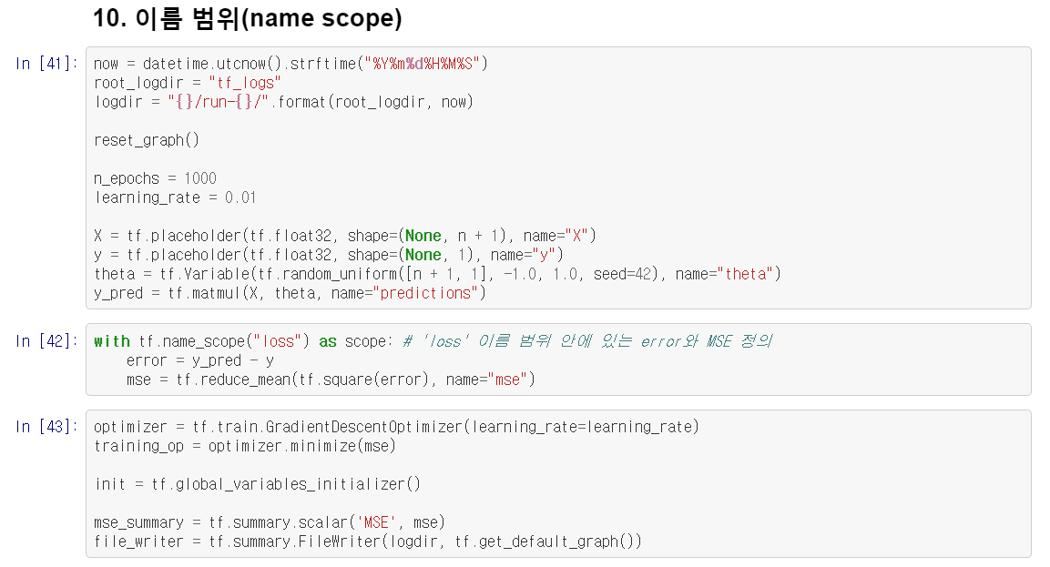
Chapter 9

Slide 26
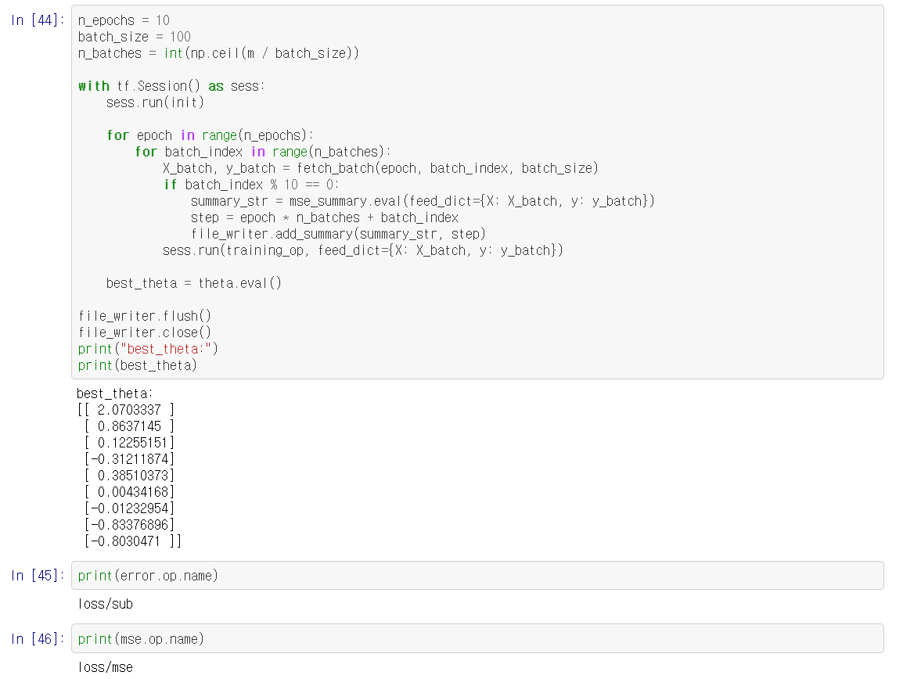
Chapter 9

Slide 27
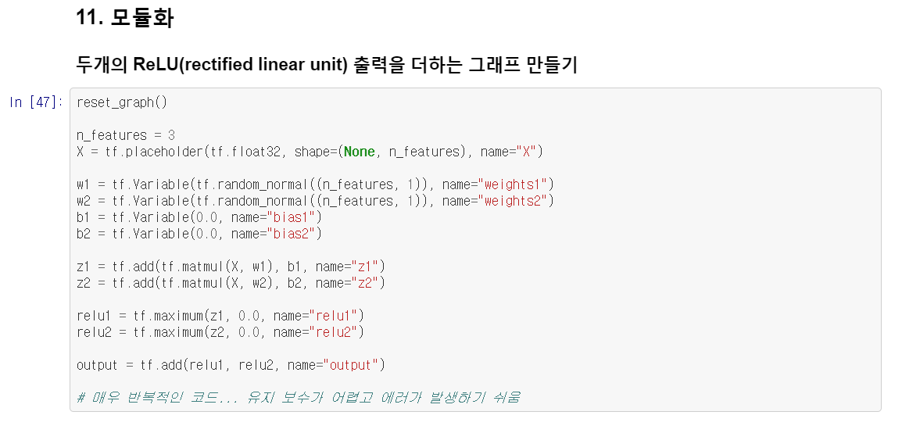
Chapter 9

Slide 28
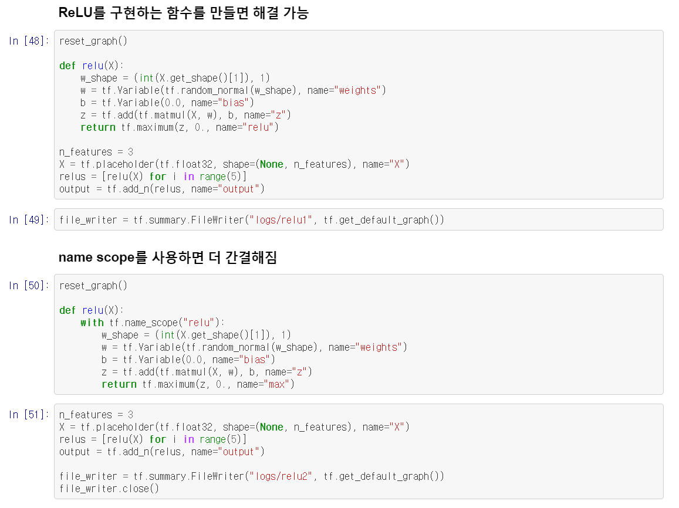
Chapter 9

Slide 29
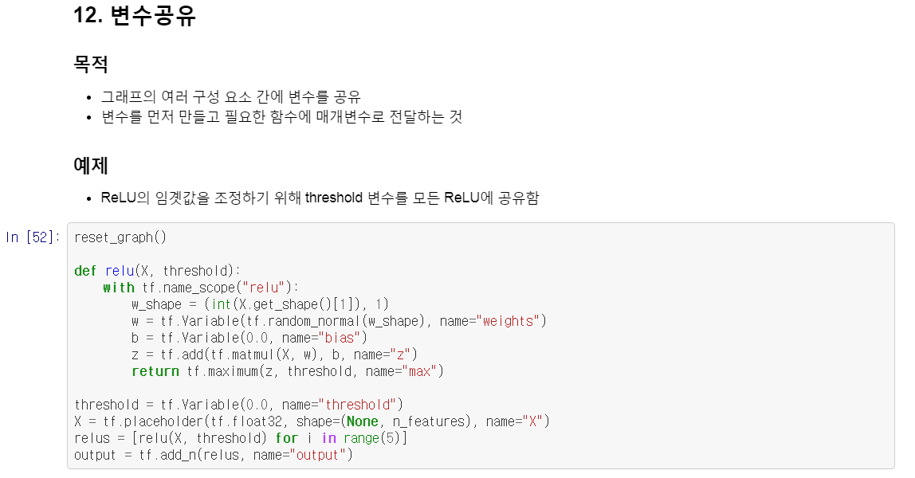
Chapter 9

Slide 30
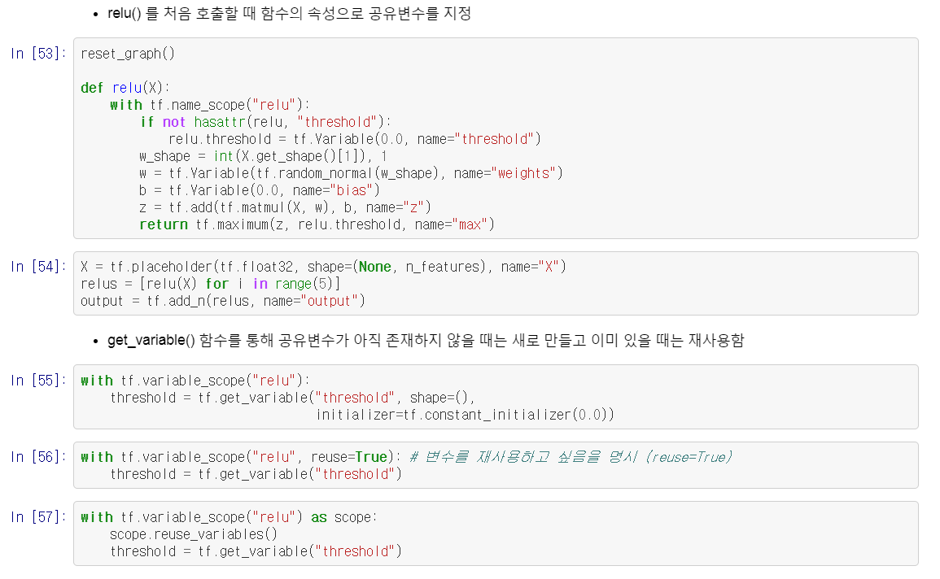
Chapter 9

Slide 31
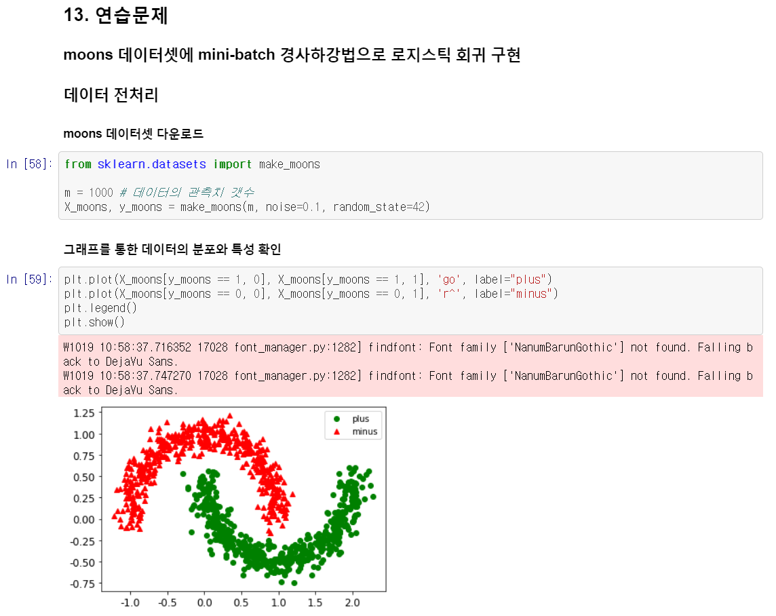
Chapter 9

Slide 32
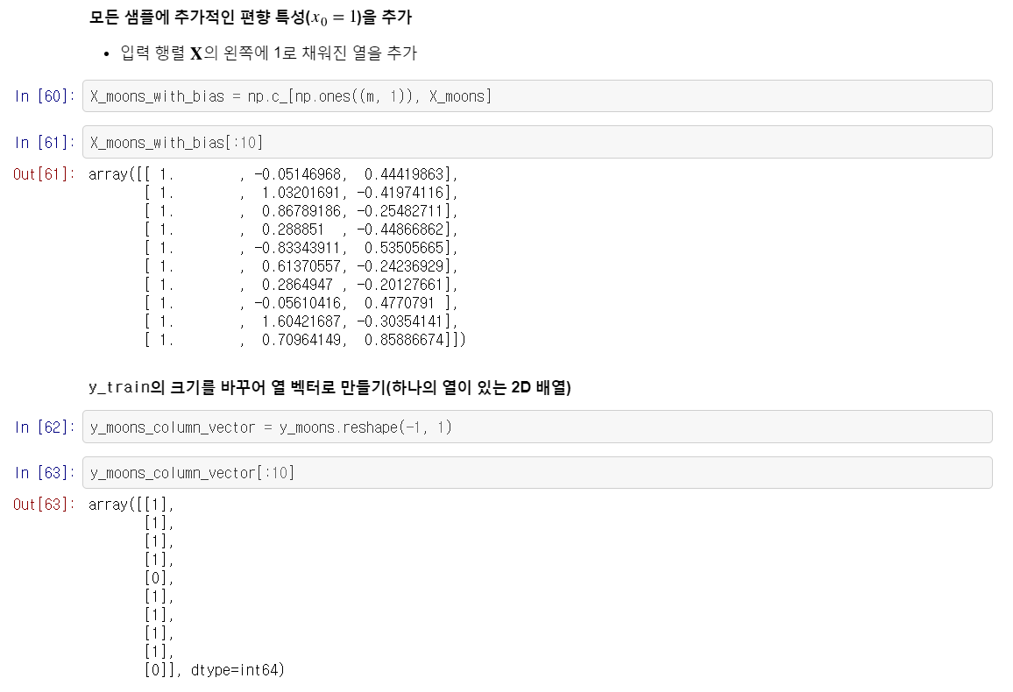
Chapter 9

Slide 33
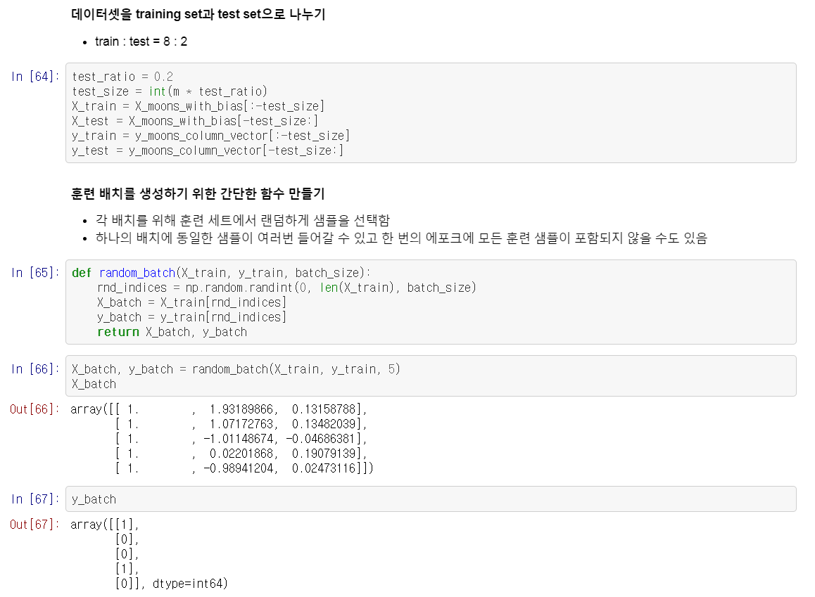
Chapter 9

Slide 34
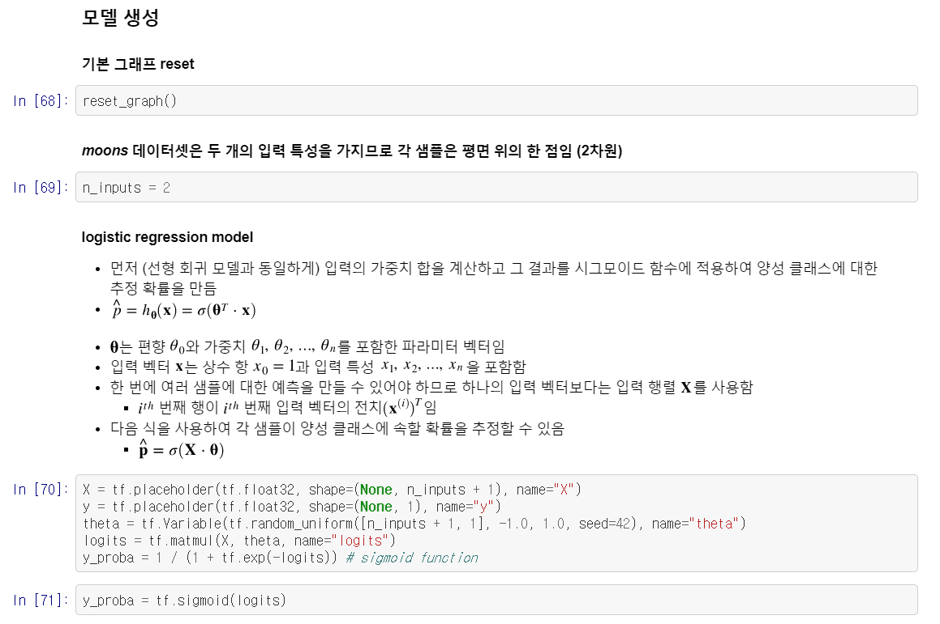
Chapter 9

Slide 35
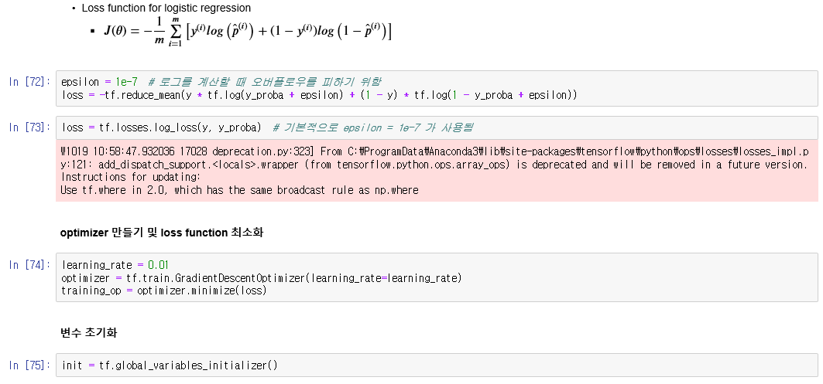
Chapter 9

Slide 36
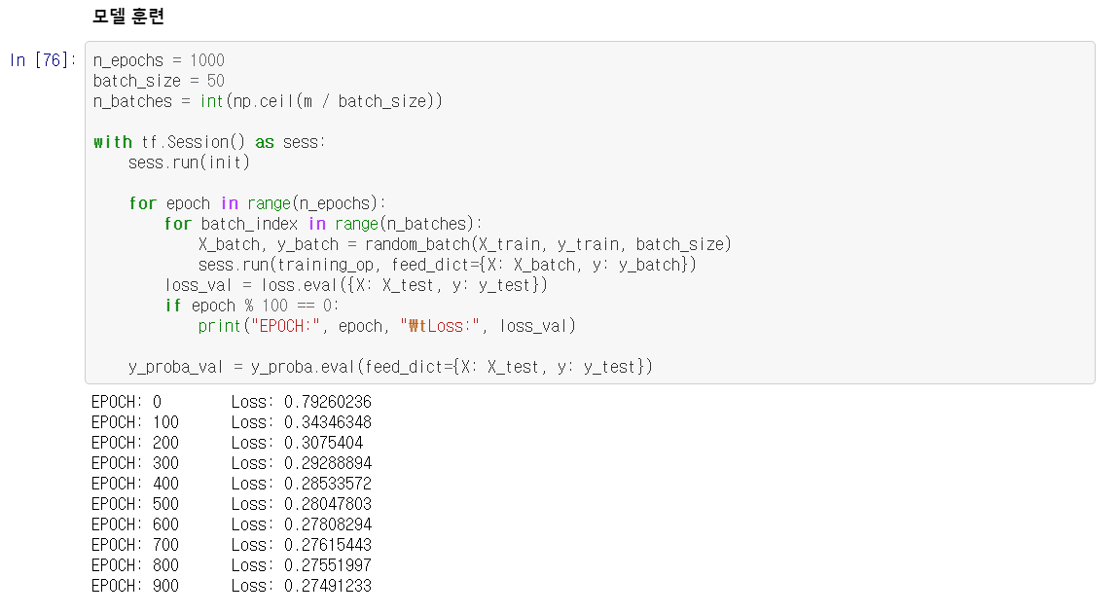
Chapter 9

Slide 37
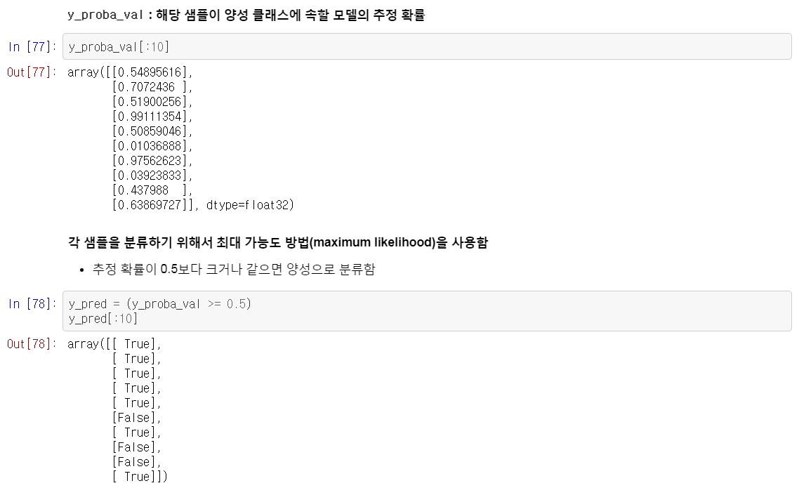
Chapter 9

Slide 38
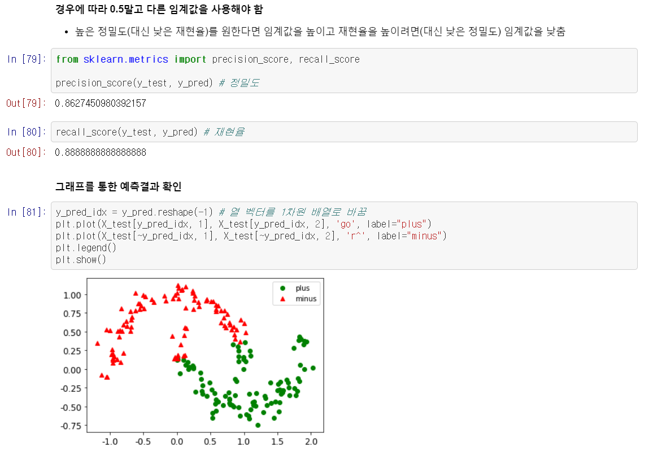
Chapter 9

Slide 39
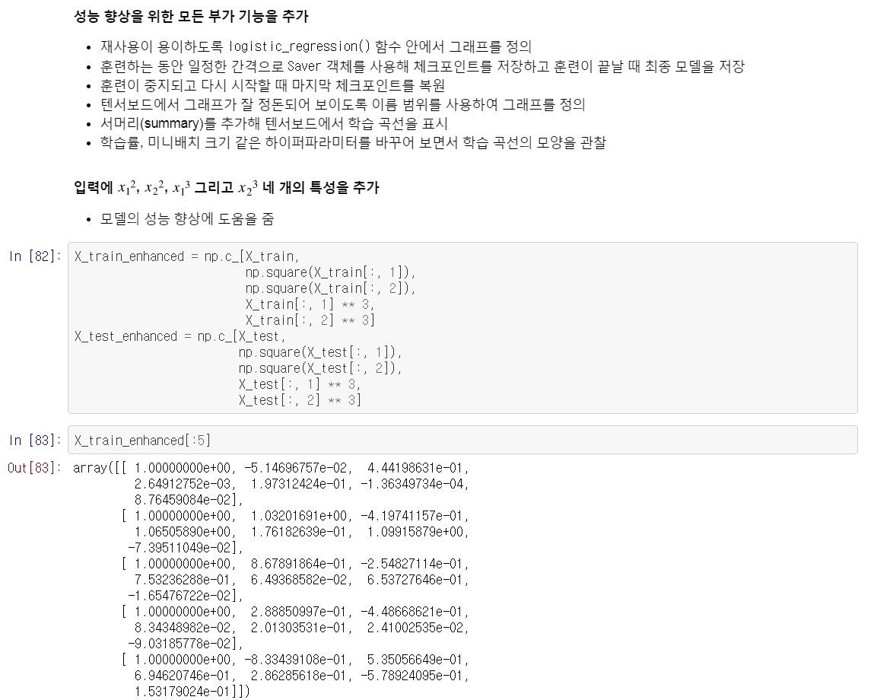
Chapter 9

Slide 40
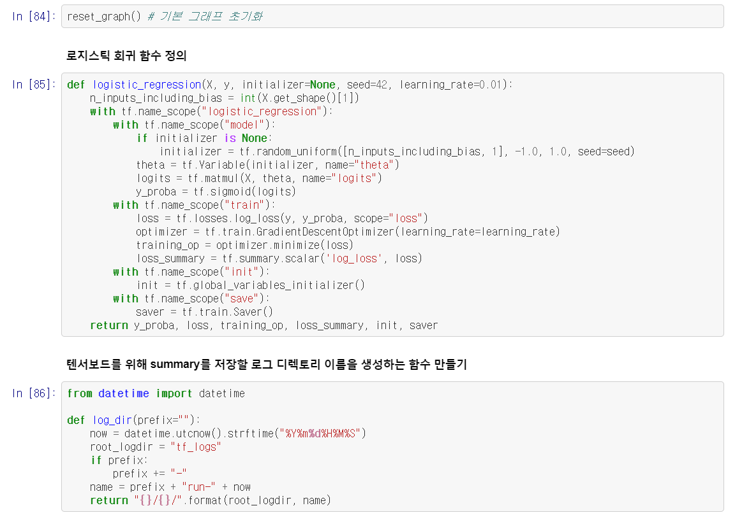
Chapter 9

Slide 41

Chapter 9

Slide 42
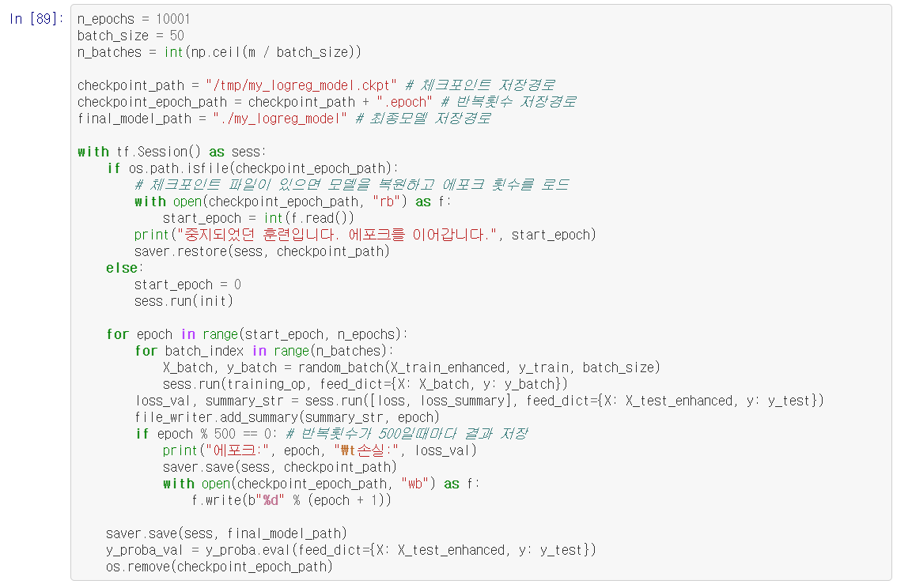
Chapter 9

Slide 43
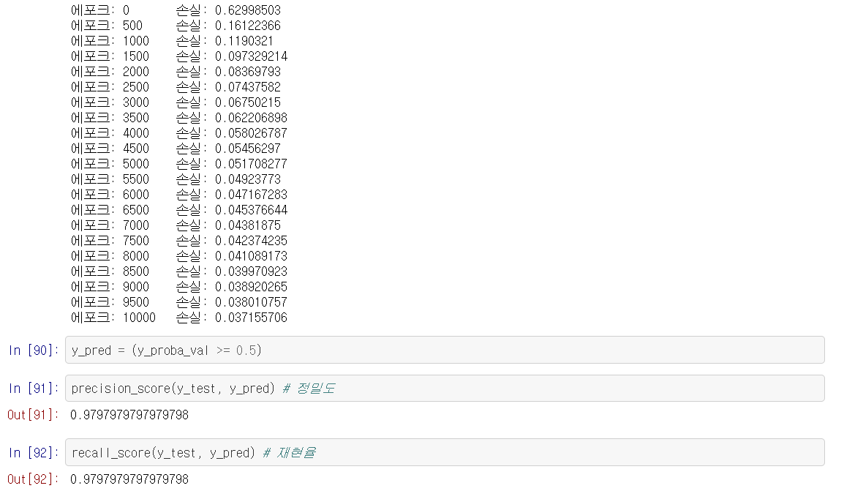
Chapter 9

Slide 44
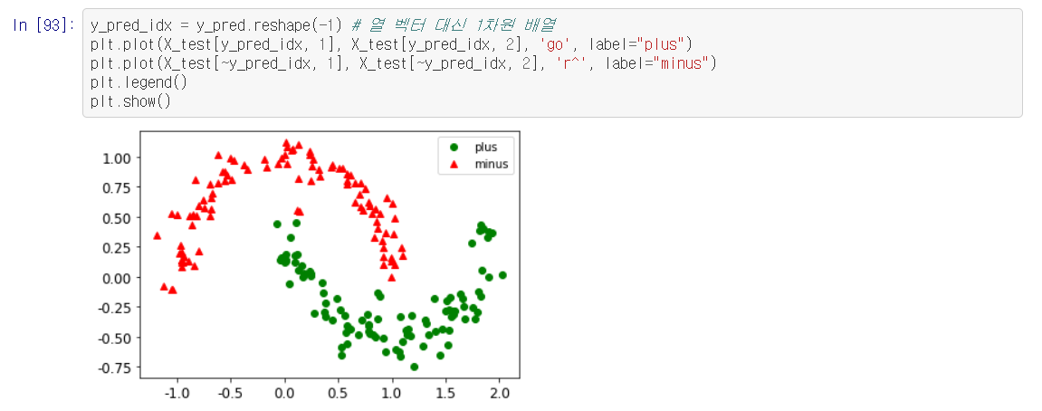
Chapter 9

Slide 45
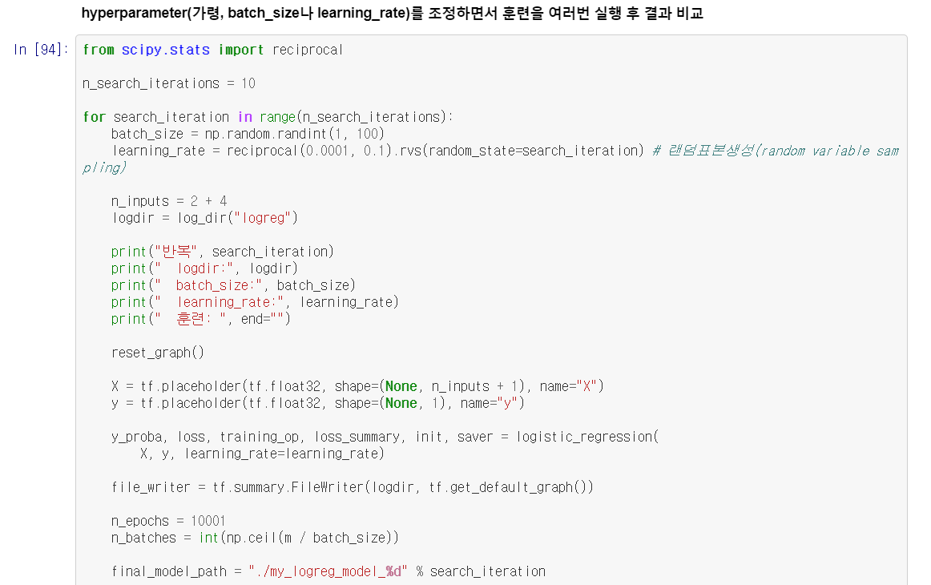
Chapter 9

Slide 46
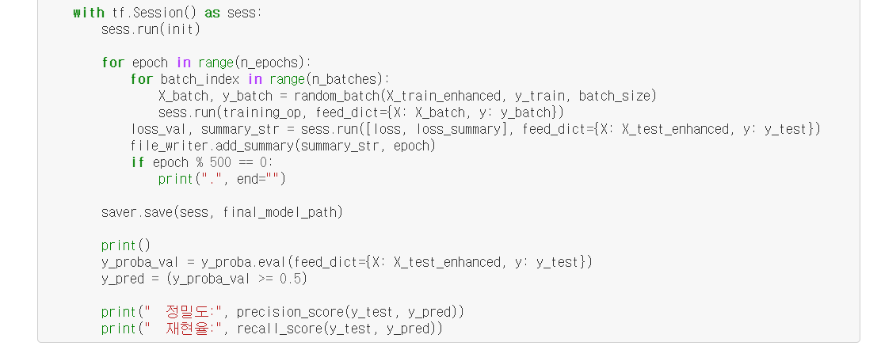
Chapter 9

Slide 47
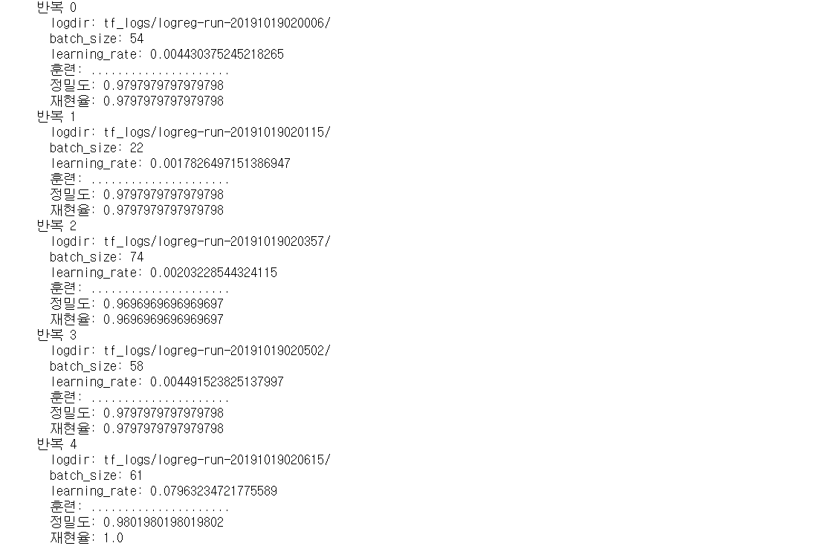
Chapter 9

Slide 48
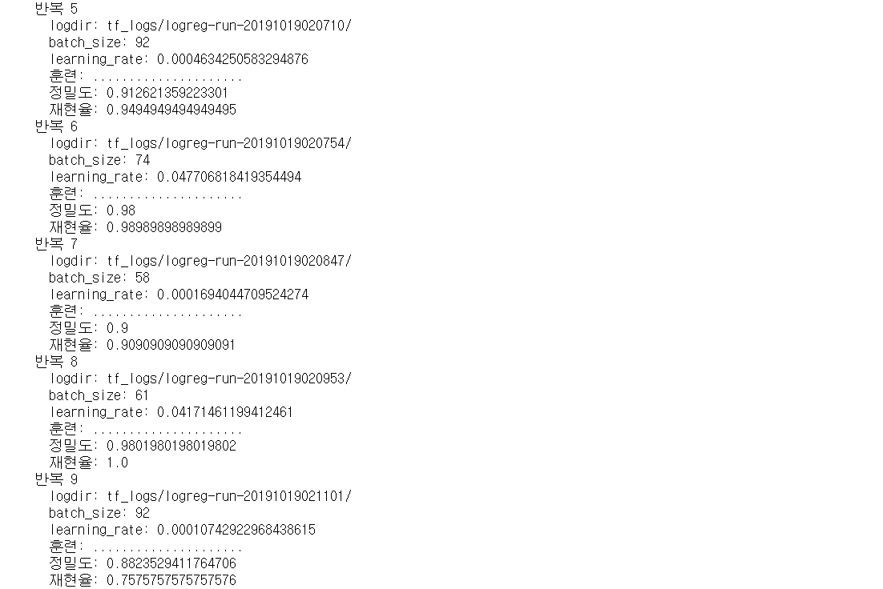
Chapter 9

